Slide 1
WELCOME
We will start the webinar shortly
Please place your phone/PC on mute during the presentation
The webinar will be recorded, a copy of the recording will be sent to you
Feel free to ask questions throughout the presentation via the Q/A or chat pod

Slide 2
CEMS Technology for Alberta CEMS compliance
Mr. Nilesh Davé
Sales Manager
(403) 532-9909

Slide 3

Agenda
Introduction to Thermo Fisher Scientific
Environment and Process Monitoring
Instrument Manufacturer
Markets / Industries Served
What is CEMS and Why do we use them?
CEMS Basic Techniques and Technologies
Sampling Techniques
Principles of Gas Measurement
Communications
Design Considerations
Gas Analyzer and Functions available
Discuss 2018 AB CEMS code draft

Slide 4

A Mission we are proud of
We enable our customers to make the world healthier, cleaner and safer
Notes:
Talking points:
At our core we are scientists and our purpose is to enable our customers to fulfill their scientific purpose

Slide 5







70,000
5,000
$1B
$23B
employees
R&D Scientists/Engineers
invested in R&D
in revenues
The world leader in serving science
Notes:
Talking points
Thermo Fisher “At a Glance”
We never leave a customer behind
Unmatched capabilities
Here’s what we are hearing/seeing/understanding in the market based on customers like you….
About us
Employees = global thought-leadership in all areas of science and harnessing the power of all that knowledge (10,000 customer-facing, so we can always be there for our customers)
Scientists = no matter what science, we have focused experts and scientists in-house that are focused on the same things
R&D = we are committed to advancing science and staying ahead of innovation
Revenues = we are not going anywhere, ‘insurance policy’

Slide 6


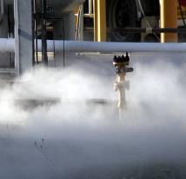
Environment and Process Monitoring
Headquartered in Franklin, Massachusetts
Three global manufacturing sites, four systems integration facilities
Global sales presence, more than 100 distributors in 30+ countries
More than 100 products using innovative, advanced technologies
Ambient Air
Source
Industrial Hygiene

Slide 7



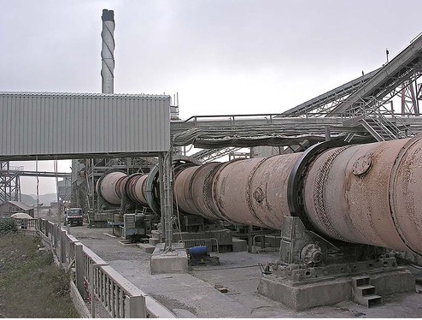
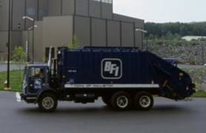
Industry and Markets
Oil and Gas
Power Generation
Pulp & Paper
Industries Served Include
Cement
Waste Incineration

Slide 8
What is CEMS and why do we use them?
CEMS – Continuous Emissions Monitoring System
Probe
Umbilical
Analyzers
DAHS (Data Acquisition Handling System)
Others PLC, Calibration Gas..
Government regulatory agencies, want to know the criteria pollutants emitted into the atmosphere.
Thus Federal and Provincial CEMS Codes were generated.

Slide 9

Sample Acquisition Techniques
In-Situ Systems
Cross Stack
In Stack
Full Extractive Systems
Cold/Dry
Hot/Wet
Dilution-Extractive Systems
Wet Basis Dilution
Dry Basis Dilution

Slide 10
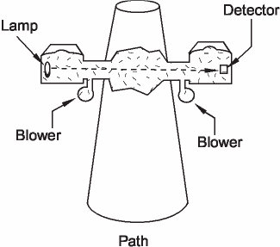
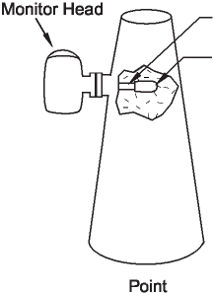

In-Situ Cross Stack and Point
Cross Stack
In Stack
Support Tube
Sensing Volume

Slide 11
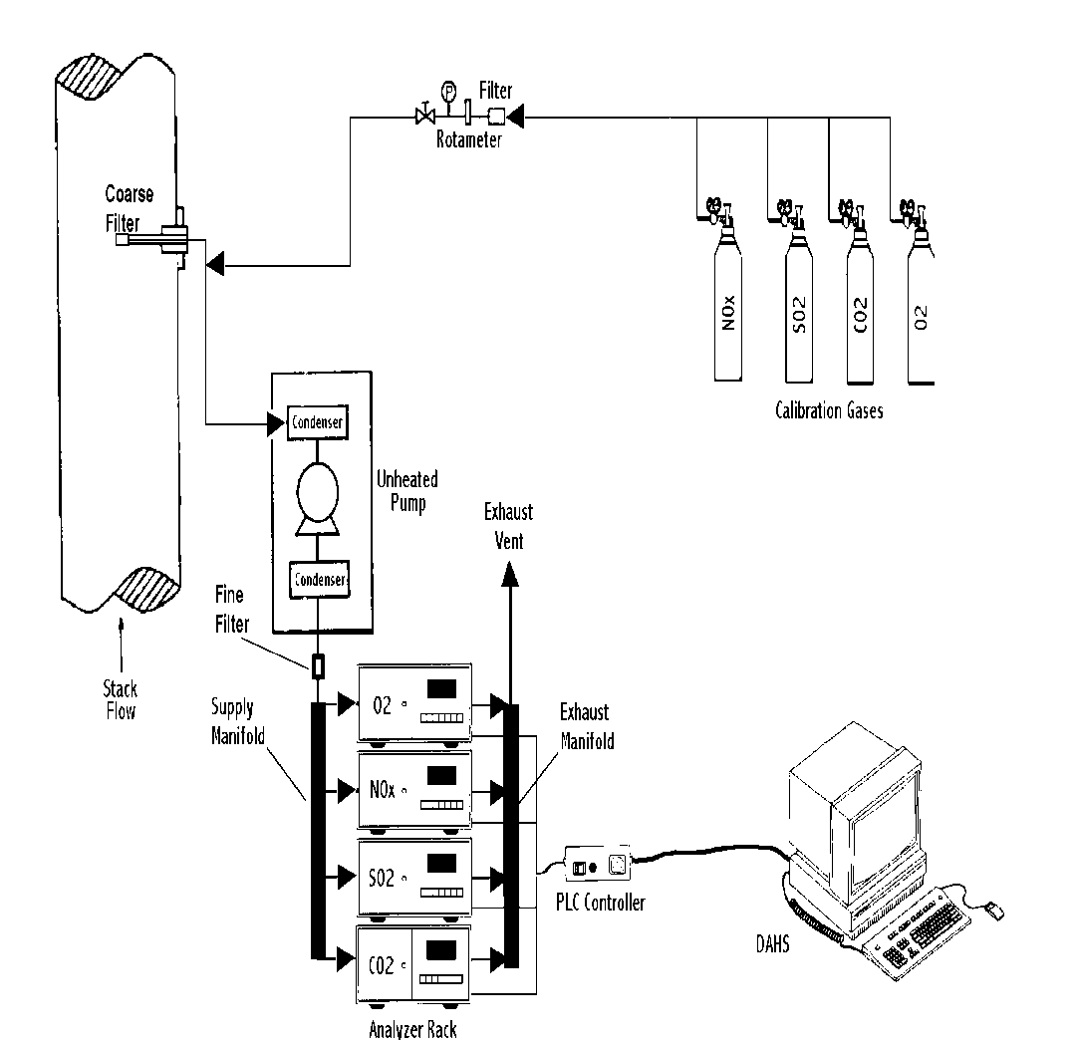
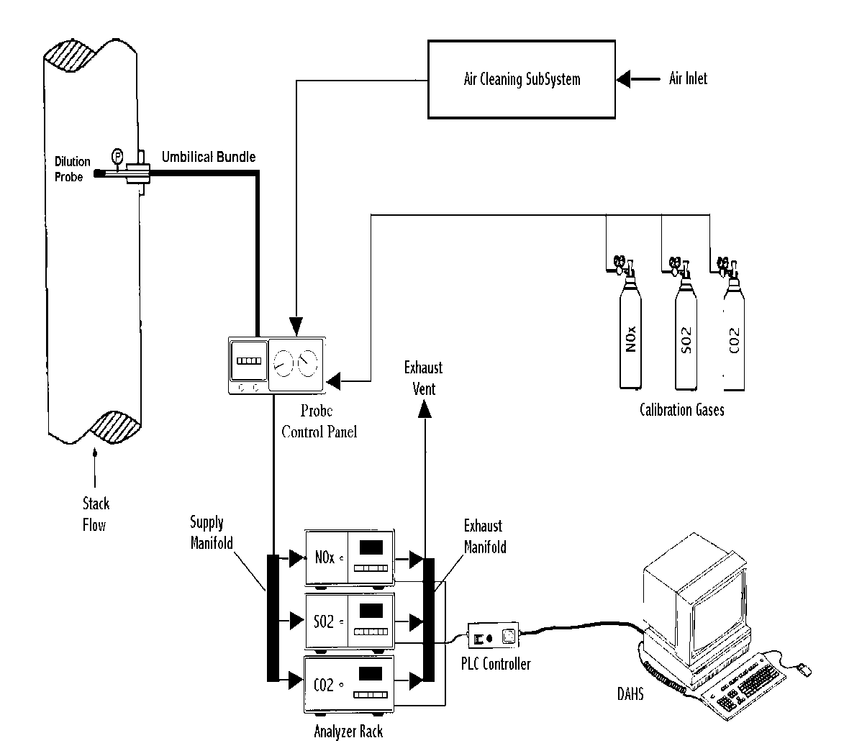
Overview of CEMS Technologies Dilution vs. Full Extractive Sampling System
Full Extractive
Dilution Extractive
Heated umbilical

Slide 12
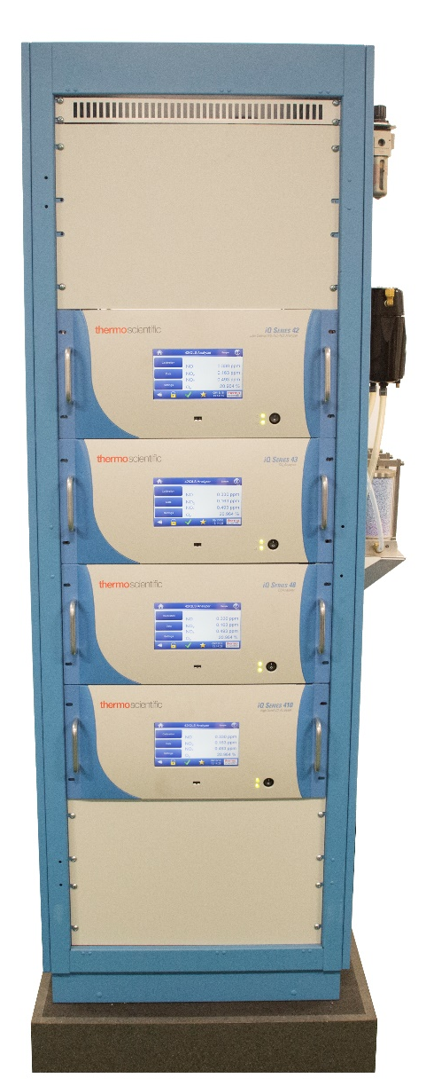
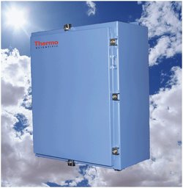
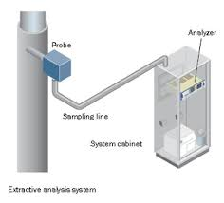
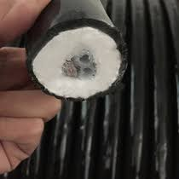
Extractive CEMS

Slide 13
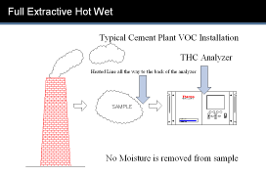
What Types Of Systems – Full Extractive
Full-Extractive (Non-dilution)
Extractive because the sample is removed from the stack before analysis
No dilution takes place
Typically a Cold/Dry sample
Sample conditioner removes the moisture
Also available as Hot/Wet system (i.e.; FTIR)
Full Extractive Hot Wet
Used for the FTIR System
THC analyzers at Cement Plants

Slide 14
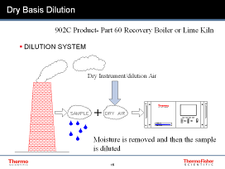
What Types Of Systems – Dilution Extractive
Dilution-Extractive:
Extractive because the sample is removed from the stack before analysis
Dilution because the sample is diluted (typically at the stack) with clean dry air 100:1
We offer both wet basis and dry basis dilution systems

Slide 15
Full Extractive – Hot / Wet Basis

Slide 16
Full Extractive - Dry Basis
Moisture Removed by sample chiller

Slide 17
Wet Basis Dilution
Dry Instrument/dilution Air
Sample is diluted, but no Moisture Is removed from the sample

Slide 18
Dry Basis Dilution
Dry Instrument/dilution Air
Moisture is removed and then the sample is diluted

Slide 19
Design Considerations
Mitigate Risk
Reduce the need to work on the stack
Is it designed for our weather? Down to -40C or lower
Increase your chances of passing RATA. (RATA – Relative Accuracy Test Audit)
Use “like” technologies
Increase your CEMS availability. 90%> is required to be in compliance
Choosing instrumentation which can assist in predictive diagnostics and proactive communication
Support
Local sales and service
Must know your plant and regulations
All Stack Testers in Alberta use our analyzers
Value - Total Cost of Operations
Impact of Covid – Deal with companies with strong balance sheet

Slide 20


Introducing the iQ Series
Thermo Scientific gives customers a smart environmental monitoring solution designed for reliability, easy operation, and proactive maintenance – resulting in more control over instrument performance, costs, workflow, and data accuracy and availability.
Notes:
Thermo Scientific gives customers a smarter environmental monitoring solution – the iQ series platform; the iQ to work smarter -- designed for reliability, easy operation, and proactive maintenance – resulting in more control over instrument performance, costs, workflow, and data accuracy and availability.

Slide 21
iQ Gas Analyzers Key Platform Features
Plug and play distributed measurement and control modules
7” color touch screen
Multi-access USB capability
Customized integral PM schedule
Quad Core Processor
DMC’s to address problems before the occur
Get smarter over time
Mobile apps to assist techs

Slide 22

Non-Stop Intelligence
Predictive Diagnostics
Address problems before they occur utilizing ‘smart’ Distributed Measurement Control (DMC) modules
Non – Stop intelligence
Notes:
Non-Stop Intelligence, how?...Predictive Diagnostics…prevent issues before they happen…we have moved some of the electronic control of our instruments from the common electronics to the measurement case…making our subassemblies communicate directly to the anlayzer’s brain…allowing them to tell the analyzer when they’re not feeling quite right…I’m working ok, no red flags but something isn’t right…the analyzer can then send a message recommending the hardware is looked at or replaced…

Slide 23

Non-Stop Intelligence (continued)
Maintain optimum performance
through iQ 360 and email alerts
Proactive Communication
Non – Stop intelligence
Notes:
Proactive communication – I just spoke of an example where the analyzer can reach out via e-mail…predictive diagnostics will generate an e-mail, preventive maintenance will generate an e-mail, alarms will generate an e-mail…but there are some other serviceability features designed in the the platform that proactively communicate more detailed information…Chris and Lars will talk a little more about that tomorrow as well as the iQ360 product, a 24/7 customer support service for rapid response to equipment and service needs...

Slide 24


Non-Stop Intelligence (continued)
Non – Stop intelligence
Personal Device Connectivity
Real time 24/7 remote monitoring
through mobile phone app
Notes:
iQ Mobile app
Initially just for IOS phones and tablets so your iPhones and iPads essentially, available for free download on the Apple App Store
Mobile app benefits:
24/7 continuous remote monitoring of analyzer suite
Proactively receive alarm and maintenance alerts
Access the most up to date analyzer resources (e.g. instrument manuals, specification sheets, how-to videos, maintenance logs, quick start guides)
Order Services:
Spare parts from www.analyticalinstruments.com
Field Services Visit
Calibration certificate
Return request authorization

Slide 25
Non-Stop Intelligence (continued)
Predictive Diagnostics
Proactive Communication
Non – Stop intelligence
Personal Device Connectivity
To give you more control over
instrument performance,
data availability,
and your workday
Today and Tomorrow.
Notes:
Non-Stop Intelligence – Predictive Diagnostics, Proactive Communication, Personal Device Connectivity -- To give you more control over instrument performance, data availability, and your workday
Today and Tomorrow.

Slide 26
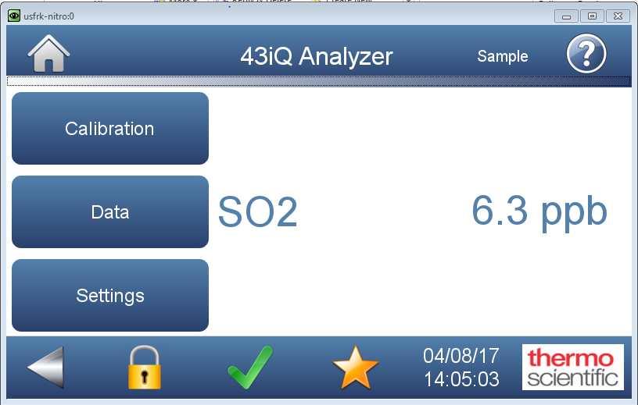
iQ Interface

Slide 27





iQ Interface Icon Help Guide
Icon | Functionality
 | Alarm status - shows that there is at least 1 alarm active. When pressed, sends user to the Status and Alarms screen.
 | Alert status - shows that there is at least 1 preventative maintenance alarm active. When pressed, sends user to the Status and Alarms screen.
 | Favorites – when pressed, sends user to the Favorites screen.
 | Thermo Scientific logo – when pressed, sends user to the Thermo Scientific Informational screen, which contains contact information for the Franklin, MA Thermo Scientific facility.
 | Icon shows up on pop-ups when there is a conflict created by the user (e.g. User enters concentration outside of acceptable limits)

Slide 28
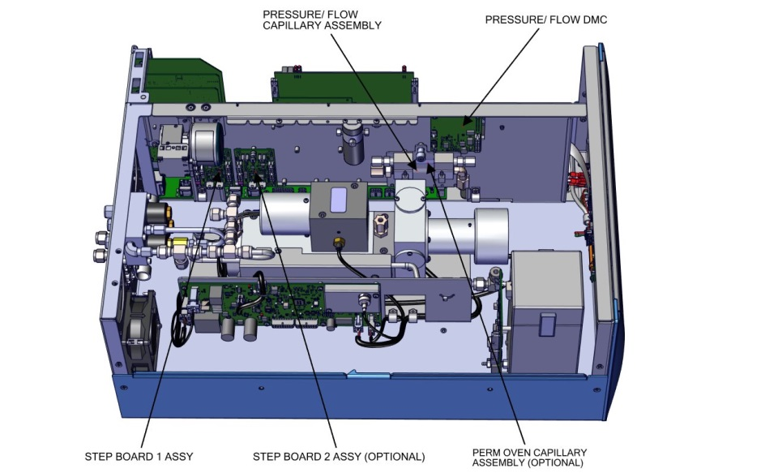
43iQ
Inside of Analyzer
Back Panel

Slide 29
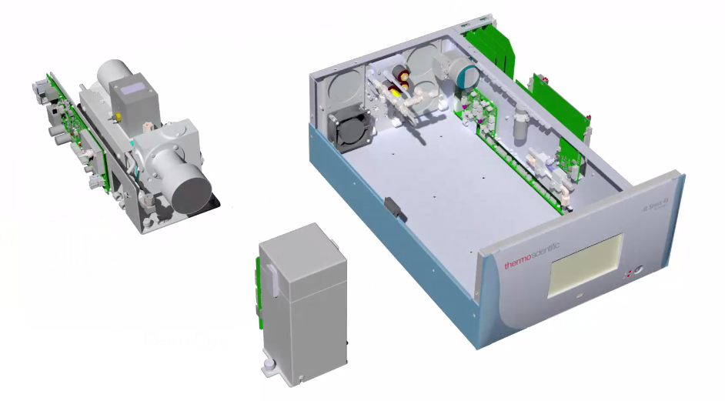
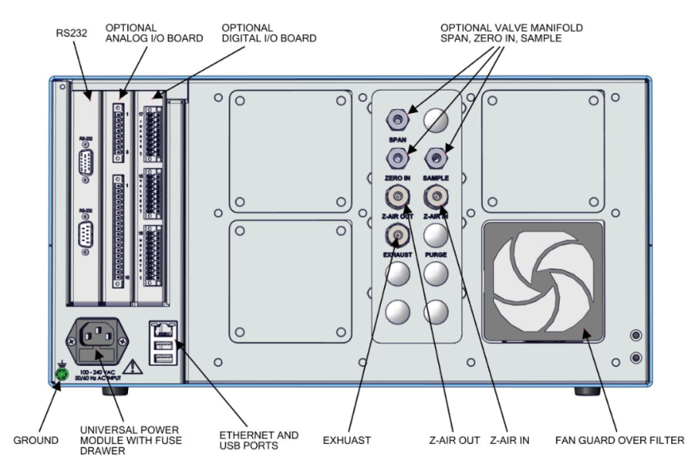
iQ layout
Inside of Analyzer

Slide 30
Principles of Gas Measurement
Pulsed Fluorescence
SO2, H2S, TRS
Chemiluminescence
NO/NO2/NOx, NH3 Slip
Non-Dispersive Infrared (NDIR) & Gas Filter Correlation
CO, CO2, HCl, N2O, Multi-Gas Analyzer
Flame Ionization Detection & Gas Chromatography
Total Hydrocarbons (THC), Methane/Non-Methane Hydrocarbons
Atomic Fluorescence
Hg
Fourier Transform Infrared Spectroscopy
Multi-Gas, NH3, HF, HCl, HCN

Slide 31


Introducing the iQ App

Slide 32
Supports the iQ Vision
Real time remote monitoring Readings and alarms
Less troubleshooting time Maintenance log display
Easier to operate Direct links to spare parts
Easier to maintain Instant access to docs
Gives customers more control over their data and their day

Slide 33

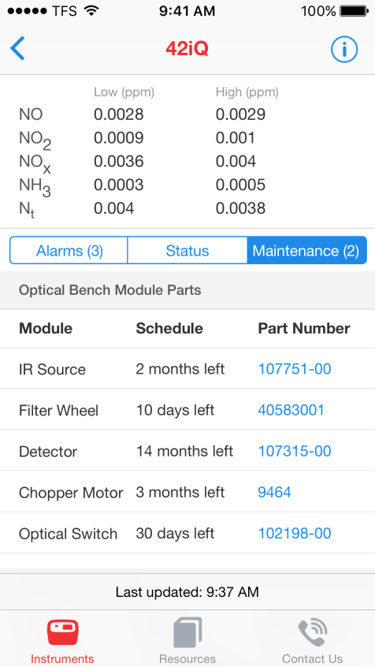
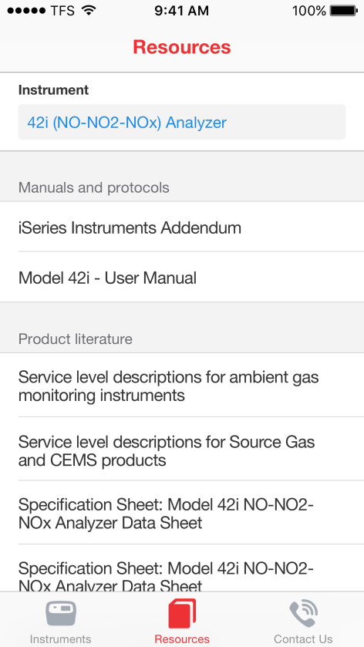
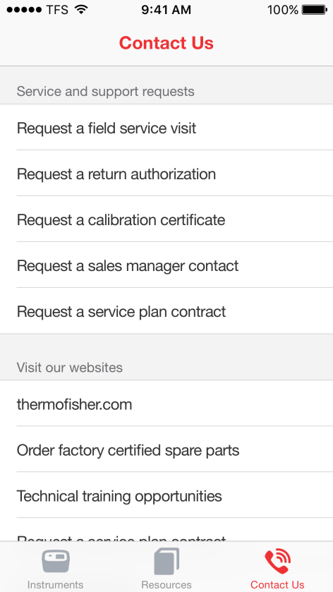
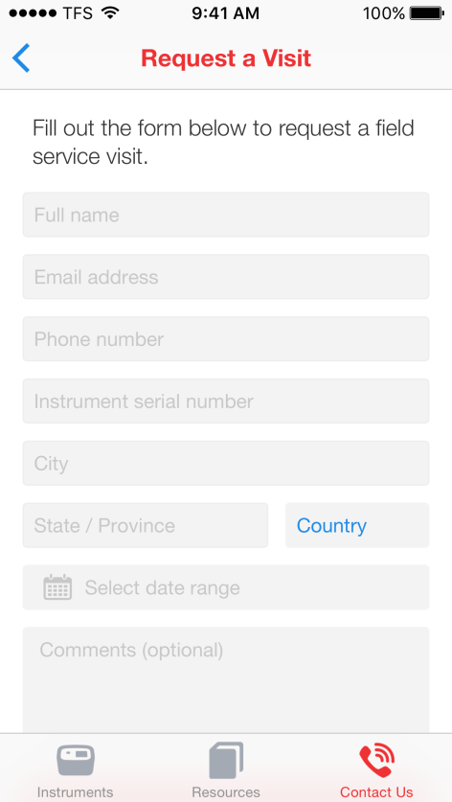
Mobile App for iOS Platforms
Available for free download on the Apple App and Google Play Store
-Functional on both iOS and Android devices
Maintenance Alerts
Resources Page
Contact Page
Field Service Visit Form

Slide 34
Available Digital Content for CEMS/Alberta CEMS Code
Digital Collateral:
42iQ low source NO-NO2-NOX Analyzer specification sheet
43iQ sulfur dioxide analyzer specification sheet
iQ Series Gas Analyzer spare parts catalog
iQ Series Gas Analyzer Platform Overview
Web:
www.thermofisher.com/cems
www.thermofisher.com/ABcemscode
www.Thermofisher.com/iqseries
Video:
iQ360 remote servicing of iQ Gas Analyzers
42iQ components and improvements
43iQ components and improvements
iQ Series Gas Analyzers – This is true control

Slide 35
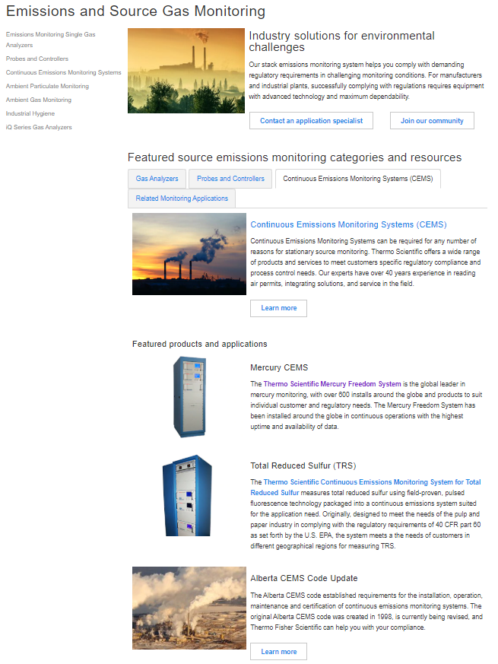
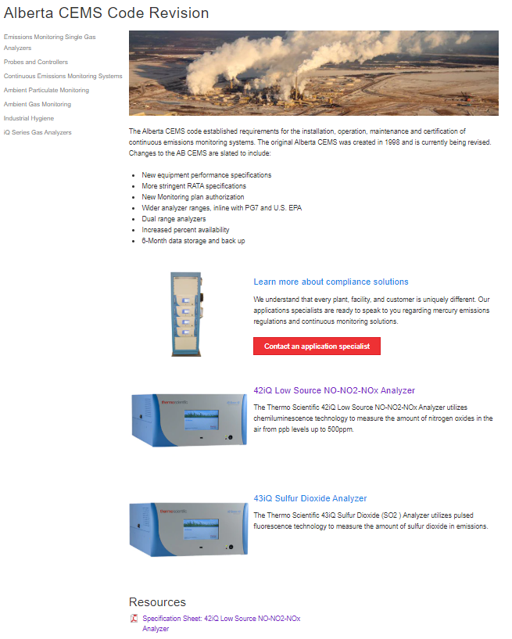
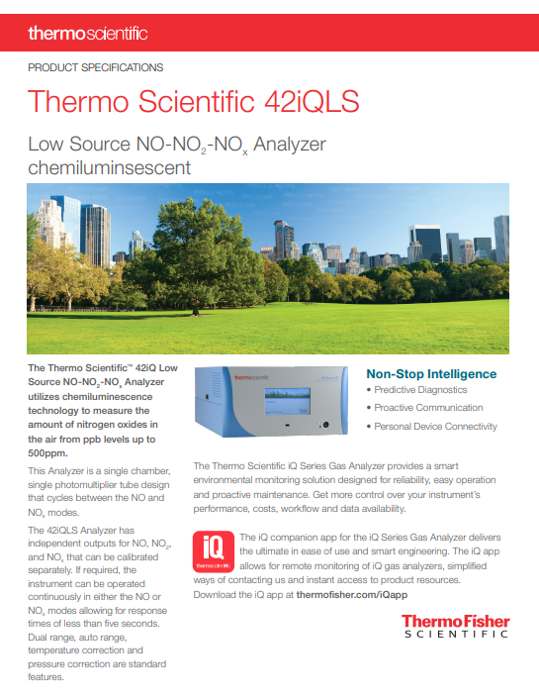
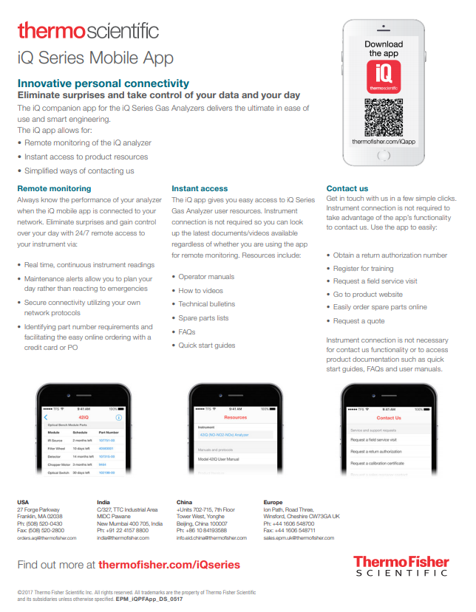
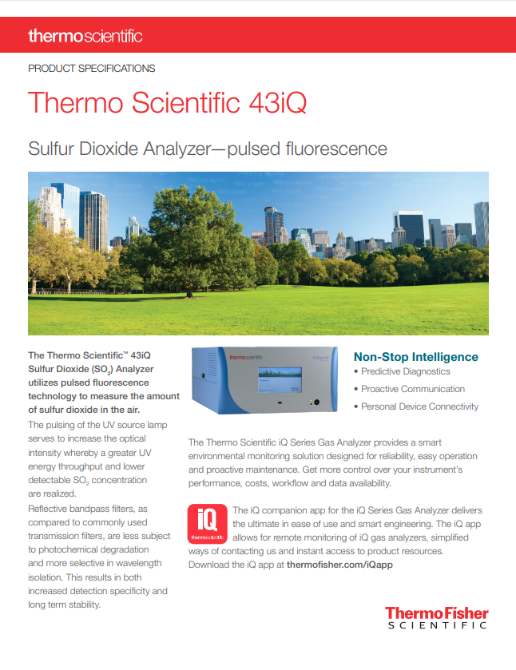
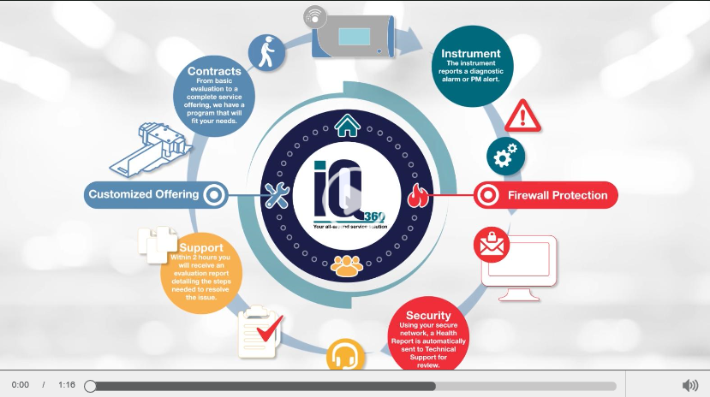
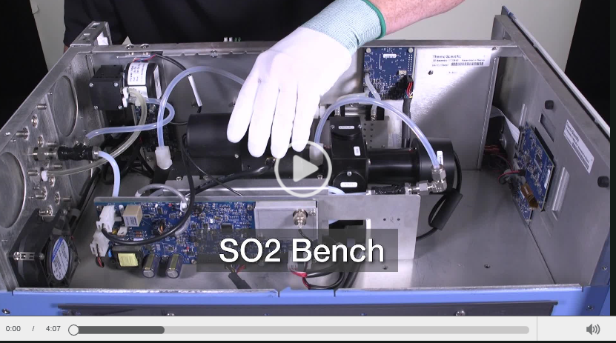
Available Digital Content for CEMS/Alberta CEMS Code

Slide 36
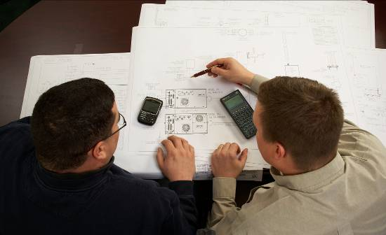
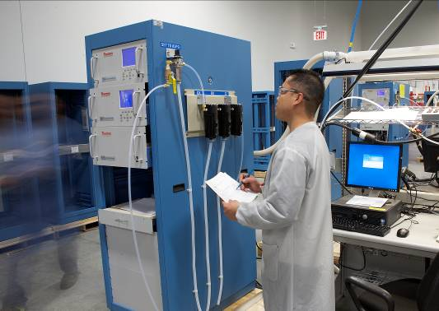
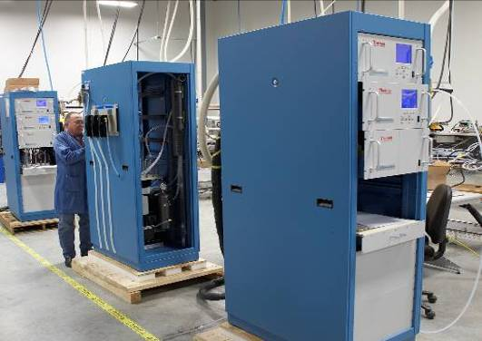
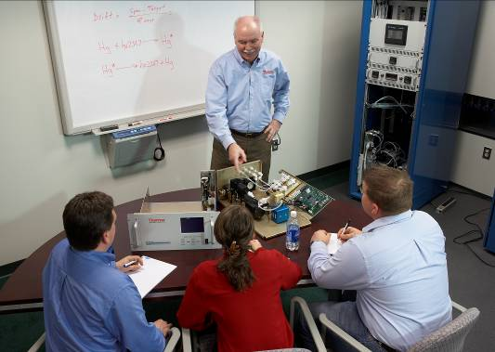
Thermo Scientific: Your Integrated Solutions Provider
Design – Project Management
Build
Service and Spare Parts
Technical Support - Training

